Slide 1
Writing a Chinese Patent Proposal

Slide 2
说明书 Patent Specification -1
发明名称 Name
技术领域 Technical Domain (1 paragraph)
Abbr. (Full English Name, Full Chinese Name)
背景技术 Background Technique
基础知识 The basic (1 paragraph)
现有技术及存在的缺陷 Current Technique and its Problems (1 paragraph)

Slide 3
说明书 Patent Specification -2
发明内容 Content 0.5-1.0 pages
发明目的 Purpose
技术方案-方法 Method
实现步骤 Implementation steps
细节说明 Explanation of details
有益效果 The better results / improvements
“与现有技术相比，本发明具有以下有益效果：”
“Comparing to current solutions, this method has the following advantages: ”

Slide 4
说明书 Patent Specification - 3
附图说明 Figures to indicate the implementations
图1 ……
图2 ……
图3 ……
具体实施方式 Specific Implementations / Examples
S101 … S10N – Steps of Example 1
S201 … S20N – Steps of Example 2
S301 … S30N – Steps of Example 3
(To help ones understand the invention)

Slide 5
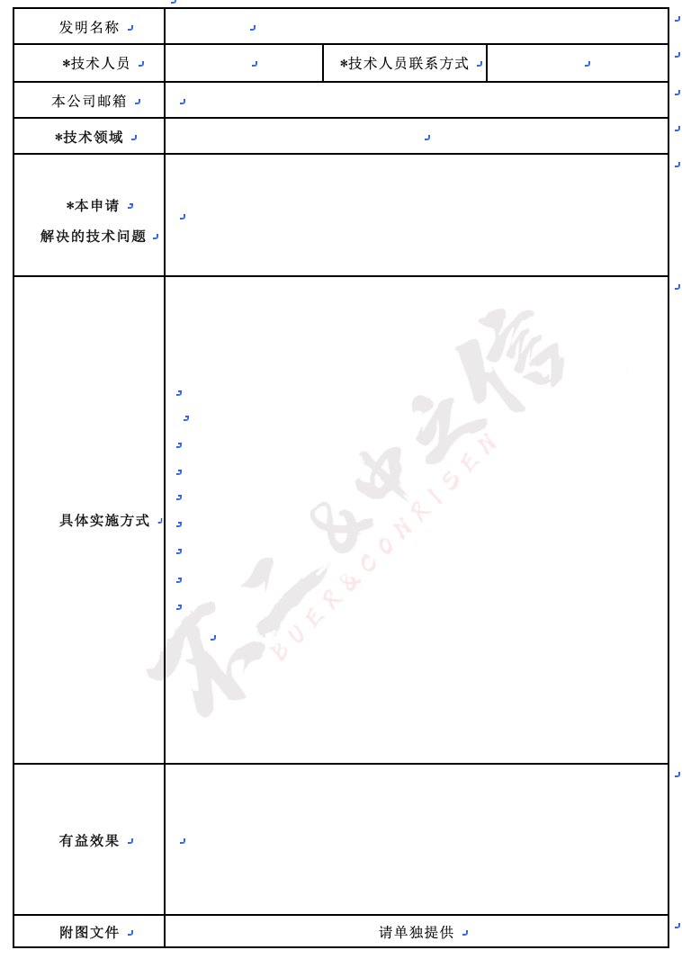

Slide 6
Next: US Patent Proposal

